Slide 1
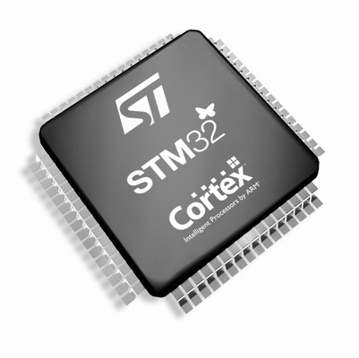
The Cortex-M3/M4 Embedded Systems: Cortex-M3/M4 Memory Systems
Refer to Chapter 6 in the reference book
“The Definitive Guide to ARM Cortex-M3 and Cortex-M4 Processors”

Slide 2
Contents
Memory Maps
Memory Access Attributes (for extensive reading)
Default Memory Access Permissions
Bit-Band Operations
Unaligned Transfers
Exclusive Accesses
Endian Mode

Slide 3
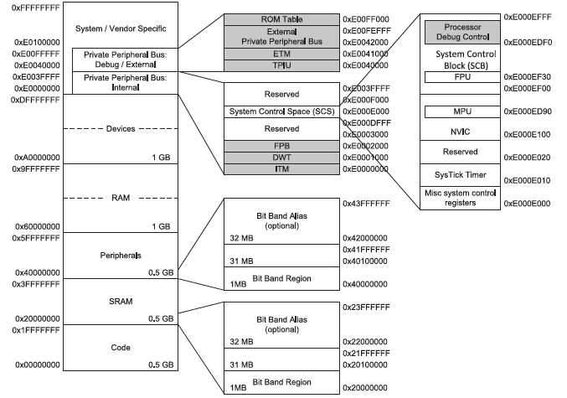

A Cortex-M3/M4 Predefined Memory Map
The Cortex-M3/M4 processor has a unified and fixed memory map
The Cortex-M3/M4 processor has a total of 4GB of address space

Slide 4
A Cortex-M3 Predefined Memory Map
CODE: 0.5 GB
primarily for program code, including the default vector table. This region also allow data accesses
SRAM: 0.5 GB
primarily for connecting SRAM, mostly on-chip SRAM, but there is no limitation of exact memory type; program execution is allowed (but slower); accessed via the system bus interface; bit-band operation
On-chip peripherals: 0.5 GB
for on-chip peripherals; bit-band operation
External RAM: 1 GB
for external (off-chip) RAM;
program execution is allowed (but slower)
External devices: 1 GB
for external (off-chip) devices
System: 0.5 GB
Internal Private Peripheral Bus (PPB): system components, e.g., NVIC, SysTick, MPU, debug components
External Private Peripheral Bus (PPB): additional optional debug components and vendor specific components.
vendor-specific area: vendor-specific components
Note that although the architecture uses names like SRAM and RAM for memory region names, there is no real limitation on what types of memories can be connected to the processors

Slide 5
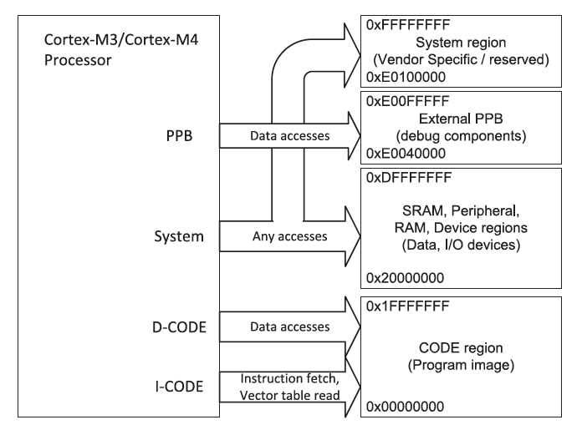
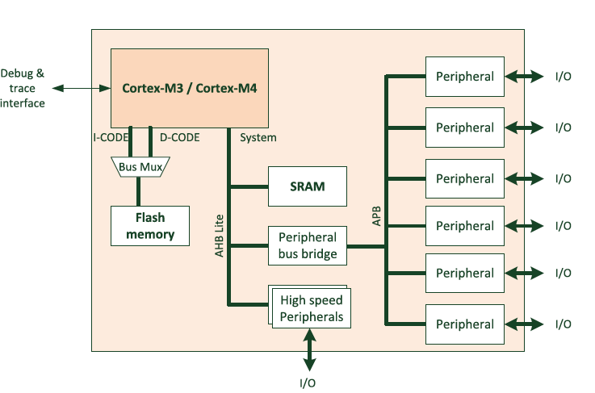
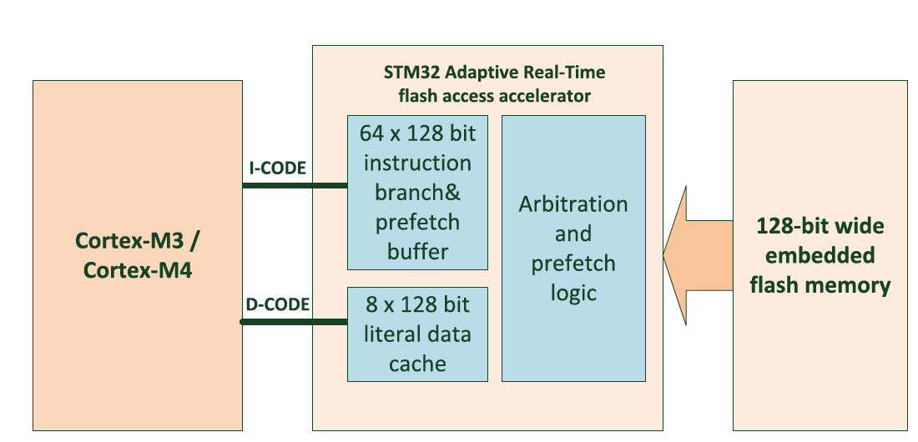
Connecting the Processor to Memory and Peripherals
the AHB (AMBA High-performance Bus) Lite protocol:
used for the main bus interfaces
the APB protocol:
used for the Private Peripheral Bus (PPB), mainly used for debug components.
Additional bus segments based on APB can be added onto the system bus by using additional bus bridge components.
One simple microcontroller design

Slide 6
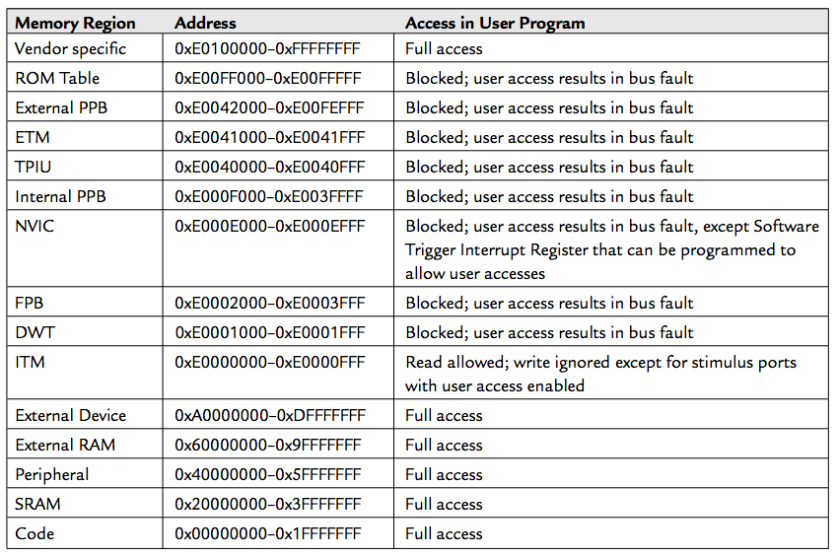
Default Memory Access Permissions
The Cortex-M3 memory map has a default configuration for memory access permissions, used when there is no MPU or MPU is disabled
Prevents user program (i.e., in user Thread mode) from accessing system control memory spaces

Slide 7
Bit-Band Operations
Bit-band operation allows a single load/store (read/write) operation to access a single data bit.
Two predefined memory regions, called bit-band regions:
the first 1 MB of the SRAM region
the first 1 MB of the peripheral region
Two associated predefined memory regions, called bit-band alias:
Bit band regions can be accessed like normal memory, but each bit within a bit band region can also be accessed using a word-aligned address in the corresponding bit-band alias

Slide 8
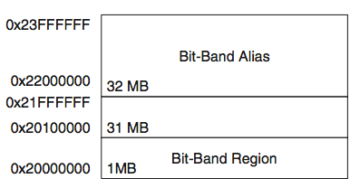
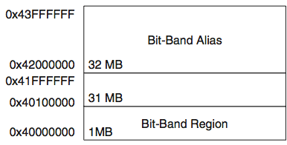
Bit-Band Region and Bit-Band Alias

Slide 9
Bit-Band Region and Bit-Band Alias
Remapping of Bit-Band Addresses in SRAM Region
Remapping of Bit-Band Addresses in Peripheral Memory Region
Bit-Band Region | Aliased Equivalent
0x20000000 bit[0] | 0x22000000 bit[0]
0x20000000 bit[1] | 0x22000004 bit[0]
0x20000000 bit[2] | 0x22000008 bit[0]
… | …
0x20000000 bit[31] | 0x2200007C bit[0]
0x20000004 bit[0] | 0x22000080 bit[0]
… | …
0x20000004 bit[31] | 0x220000FC bit[0]
… | …
0x200FFFFC bit[31] | 0x23FFFFFC bit[0]
Bit-Band Region | Aliased Equivalent
0x40000000 bit[0] | 0x42000000 bit[0]
0x40000000 bit[1] | 0x42000004 bit[0]
0x40000000 bit[2] | 0x42000008 bit[0]
… | …
0x40000000 bit[31] | 0x4200007C bit[0]
0x40000004 bit[0] | 0x42000080 bit[0]
… | …
0x40000004 bit[31] | 0x420000FC bit[0]
… | …
0x400FFFFC bit[31] | 0x43FFFFFC bit[0]

Slide 10
Write to Bit-Band Alias
A hardware READ-MODIFY-WRITE is performed
For example, to set bit 2 in word data at address 0x20000000:

Slide 11
Read from Bit-Band Alias
To read bit 2 in word data in address 0x20000000:

Slide 12
Bit-Band Operation Example
Example:
1. Set address 0x20000000 to a value of 0x3355AACC.
2. Read address 0x22000008. This read access is remapped into read access to 0x20000000. The return value is 1 (bit[2] of 0x3355AACC).
3. Write 0x0 to 0x22000008.
4. Now read 0x20000000. That gives you a return value of 0x3355AAC8 (bit[2] =0).

Slide 13
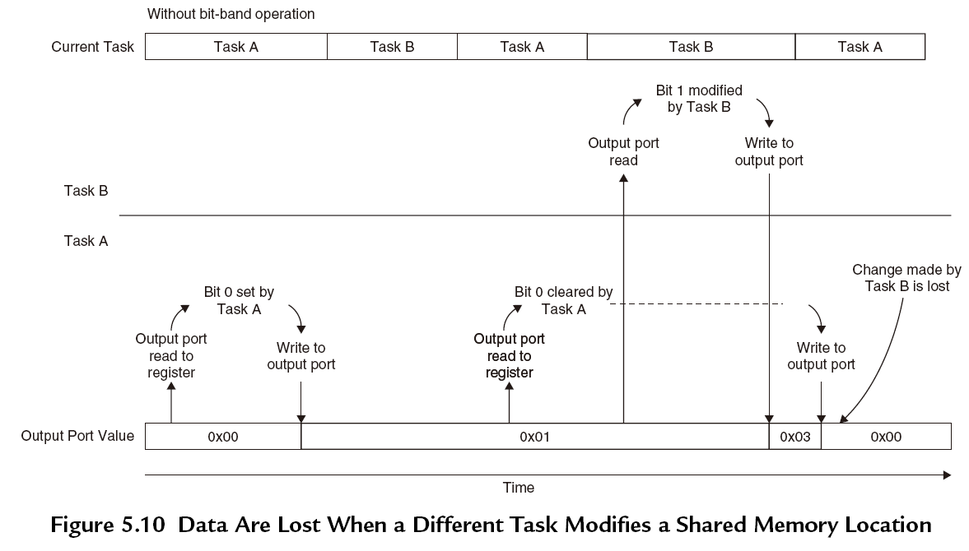
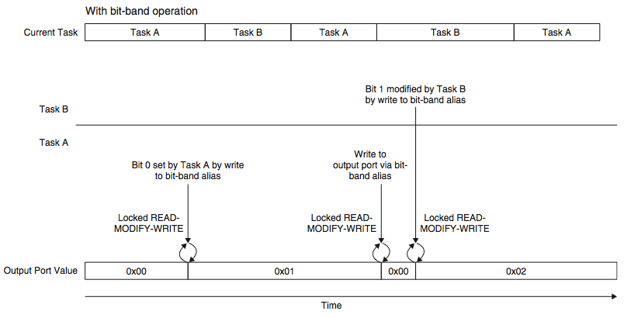
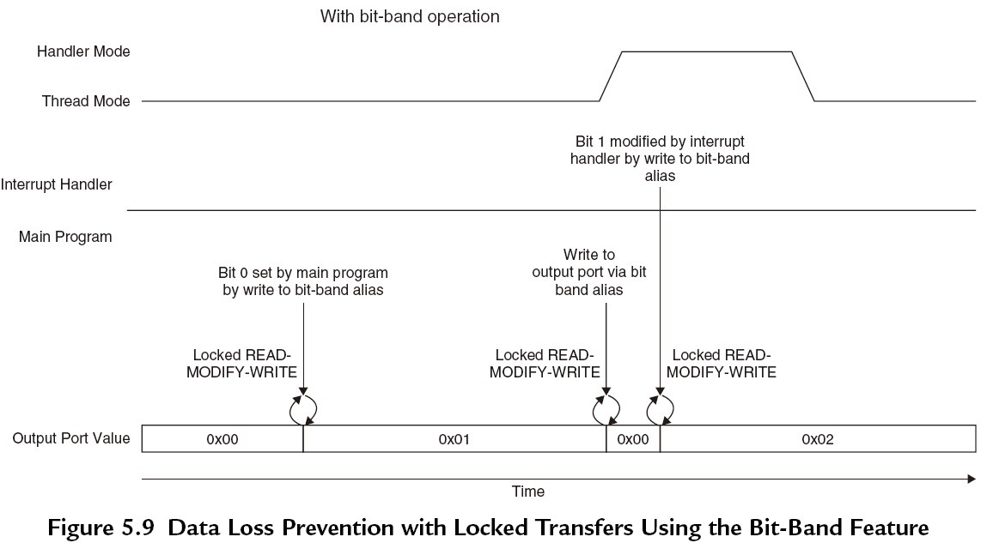
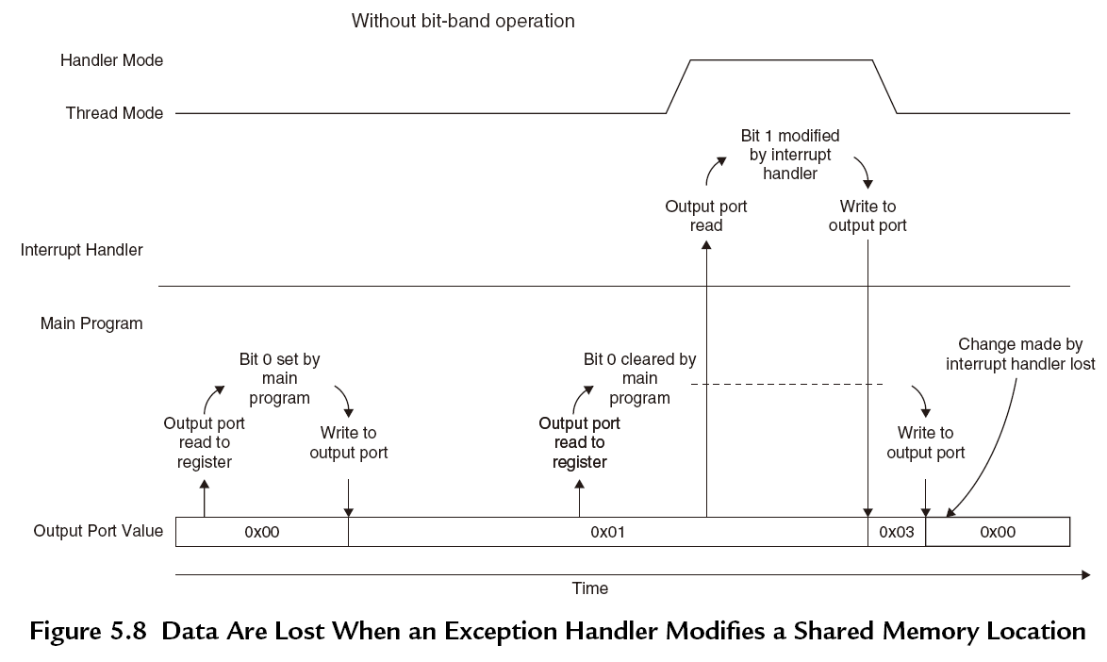
Advantages of Bit-band Operations
Faster bit operations with fewer instructions
Exclusive read/write operations (by hardware)

Slide 14
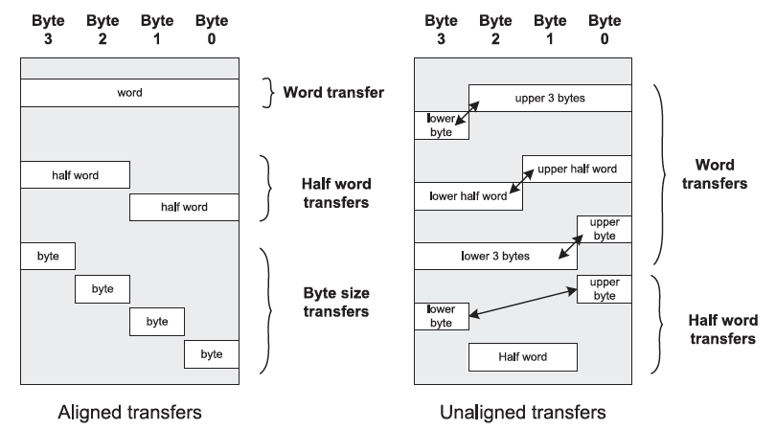
Data Alignment and Unaligned Transfers
Aligned transfers means the address value is a multiple of the size (in bytes).
The Cortex-M3 supports unaligned transfers on single accesses.
When unaligned transfers are issued by the processor, they are actually converted into multiple aligned transfers by the processor’s bus interface unit.

Slide 15
Unaligned Transfers
There are a number of limitations:
1. Not supported in Load/Store multiple instructions.
2. Stack operations (PUSH/POP) must be aligned.
3. Exclusive accesses must be aligned.
4. Unaligned transfers are not supported in bit-band operations.
When unaligned transfers are used, they are actually converted into multiple aligned transfers by the processor’s bus interface unit
Transparent to application programmers.
It takes more clock cycles for a single data access

Slide 16

Exclusive Accesses
Exclusive access instructions: LDREX,STREX
SWP instruction (swap) was used to check semaphore status in early ARM processors. But Cortex-M3 cannot support SWP any more.
1. What is semaphore?
Semaphores are commonly used for allocating shared resources to applications. When a resource is being used by one process, it is locked to that process and exclusive to others. A semaphore is the lock flag.
2. Why is exclusive access used instead of SWP instruction?
When a process or application want to use a resource, it needs to check whether the resource has been locked first.
In ARM V7 architecture, the read/write access can be carried out on separated buses. Therefore, the SWP instructions (requiring the read and write in a locked transfer sequence must be on the same bus) can no longer be used to make the memory access atomic.
Therefore, the locked transfers are replaced by exclusive accesses.

Slide 17
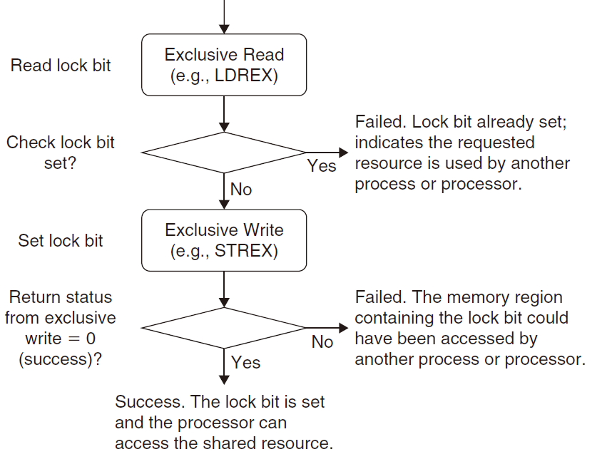
Exclusive Accesses
3. The difference between SWP instructions and exclusive access.
The concept of exclusive access operation is quite simple but different from SWP, which allows the possibility that the memory location for a semaphore could be accessed by multiple buses.

Slide 18
Exclusive Accesses
Exclusive access instructions include:
1. LDREX (word)
2. LDREXB (byte)
3. LDREXH (half word)
4. STREX (word)
5. STREXB (byte)
6. STREXH (half word)

Slide 19
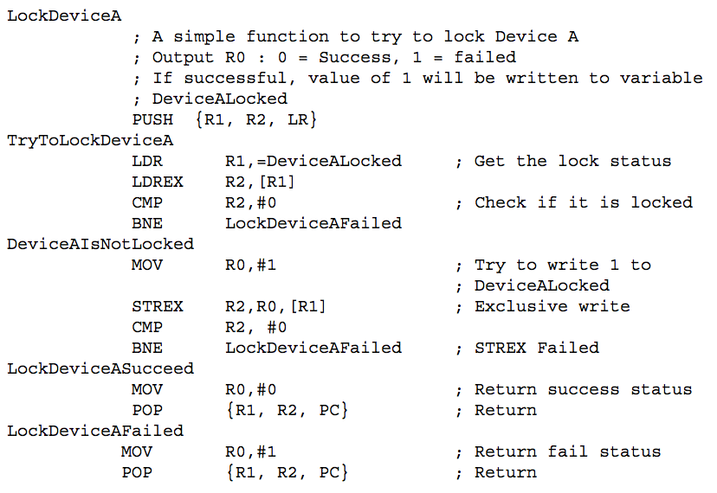
Exclusive Access Example

Slide 20
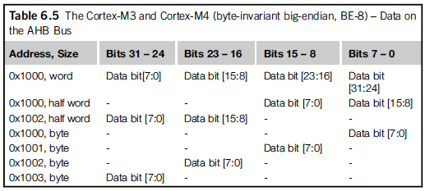
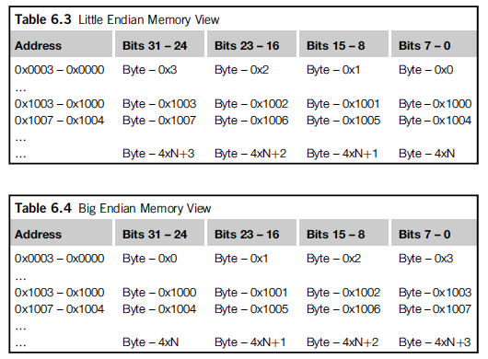
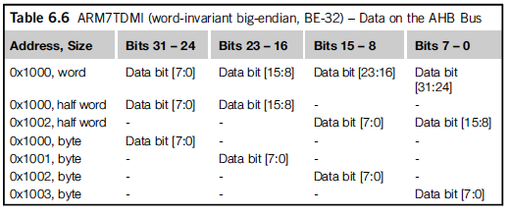
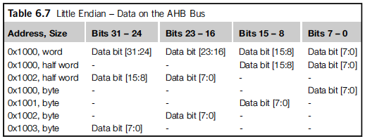
Endian Mode
The Cortex-M3/M4 supports both little endian (recommended) and big endian modes.
In the Cortex-M3/M4, the big endian scheme uses byte-invariant big endian (BE-8) byte lane usage.
Byte lane usage on the bus
Memory view

Slide 21
Endian Mode
The endian mode is set when the processor exits reset and it cannot be changed afterward.
Instructions are always in little endian, as are data accesses in the configuration control memory space and the external PPB memory range.
The data can be easily converted between little endian and big endian using instructions REV/REVH.

